Slide 1



Real-Time Chat
Institute of Advance Computing
Guide:
Prof. Garima Hardia
Developer :
Bahadur Ninama
Digpal Singh

Slide 2
Introduction
A comprehensive overview of a one-to-one chat platform.
This presentation provides an in-depth analysis of real-time one-to-one chat platforms, highlighting their roles, significance in contemporary communication, and essential characteristics.

Slide 3
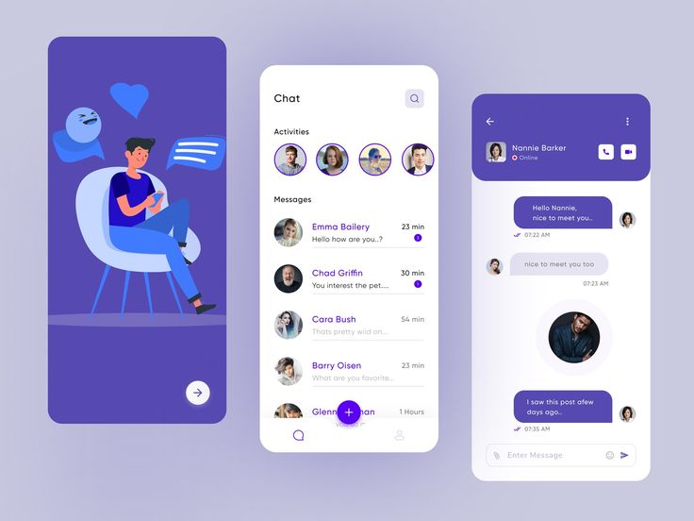
Key Features
User Registration & Login
JWT-based secure authentication
Real-time one-to-one chat
Online/offline user status
Chat history saved in MongoDB

Slide 4
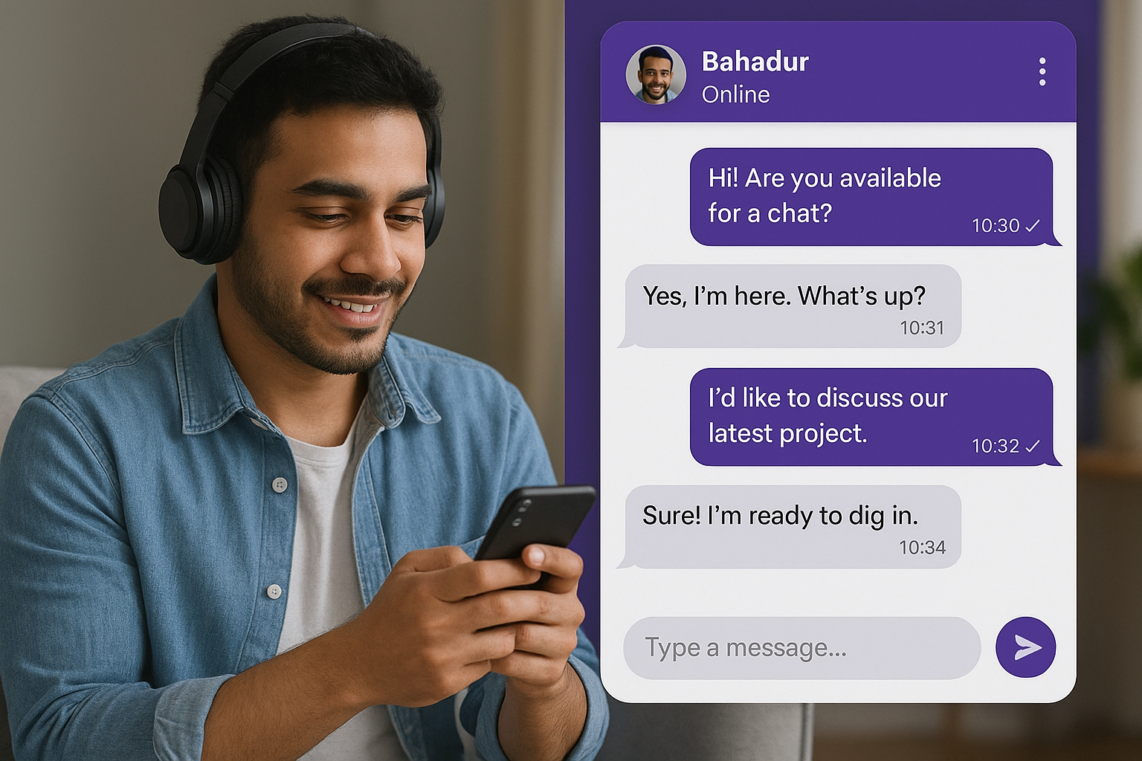
User Interface
The user interface is designed for simplicity, offering an intuitive layout, easy navigation, and customizable themes.

Slide 5

Supported Devices
The platform supports various devices, including desktops, tablets, and smartphones across different operating systems.

Slide 6
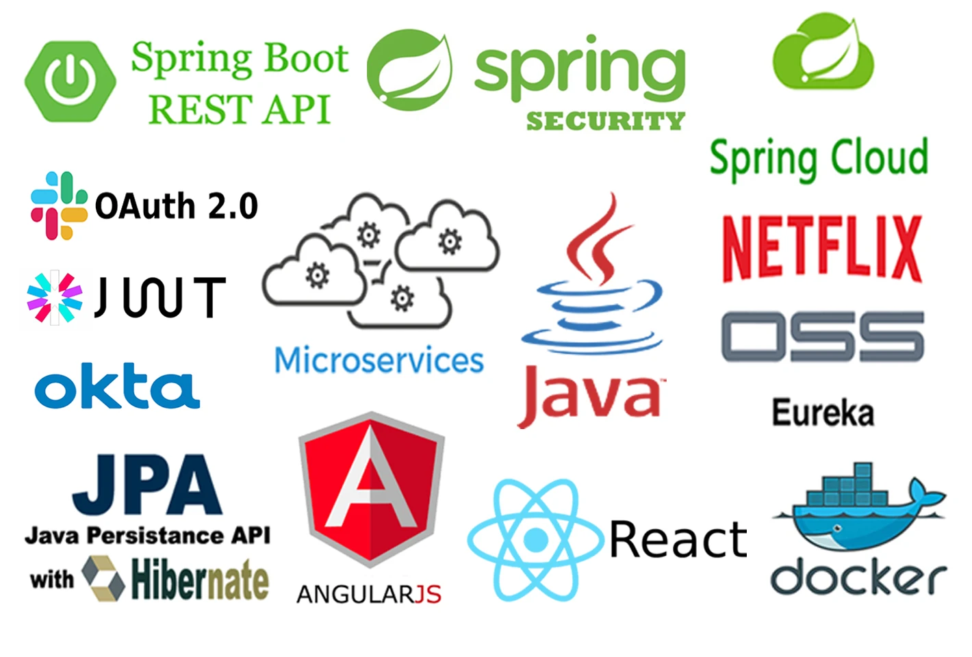
Tools & Technologies
Backend: Java Spring Boot, WebSocket (STOMP/SockJS), JWT
Frontend: ReactJS
Database: MongoDB Atlas
Other Tools: Postman, VS Code, GitHub, Heroku (for deployment)

Slide 7
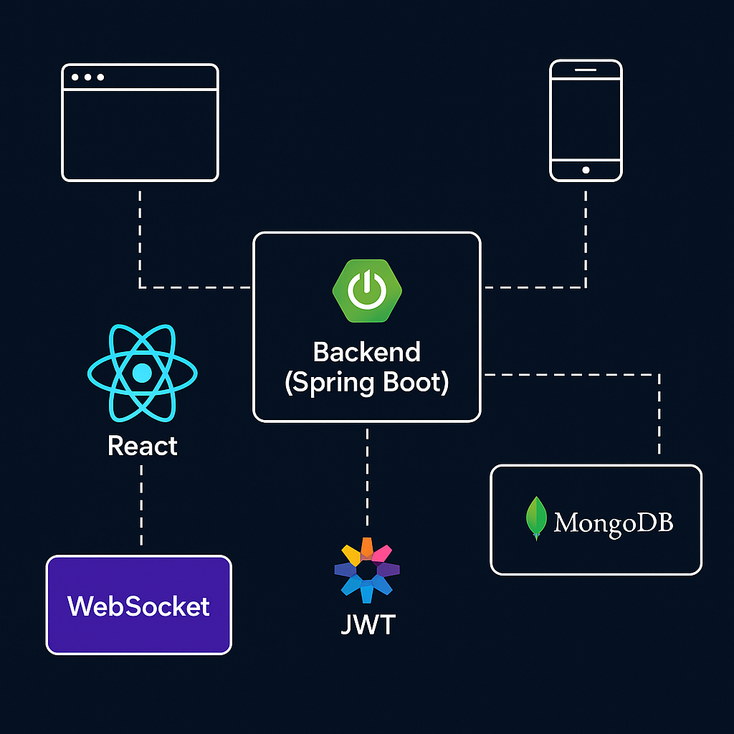
Architecture
Frontend (React) handles user interaction
Backend (Spring Boot) handles APIs, authentication, and socket communication
MongoDB stores user & message data
WebSocket enables real-time message updates

Slide 8
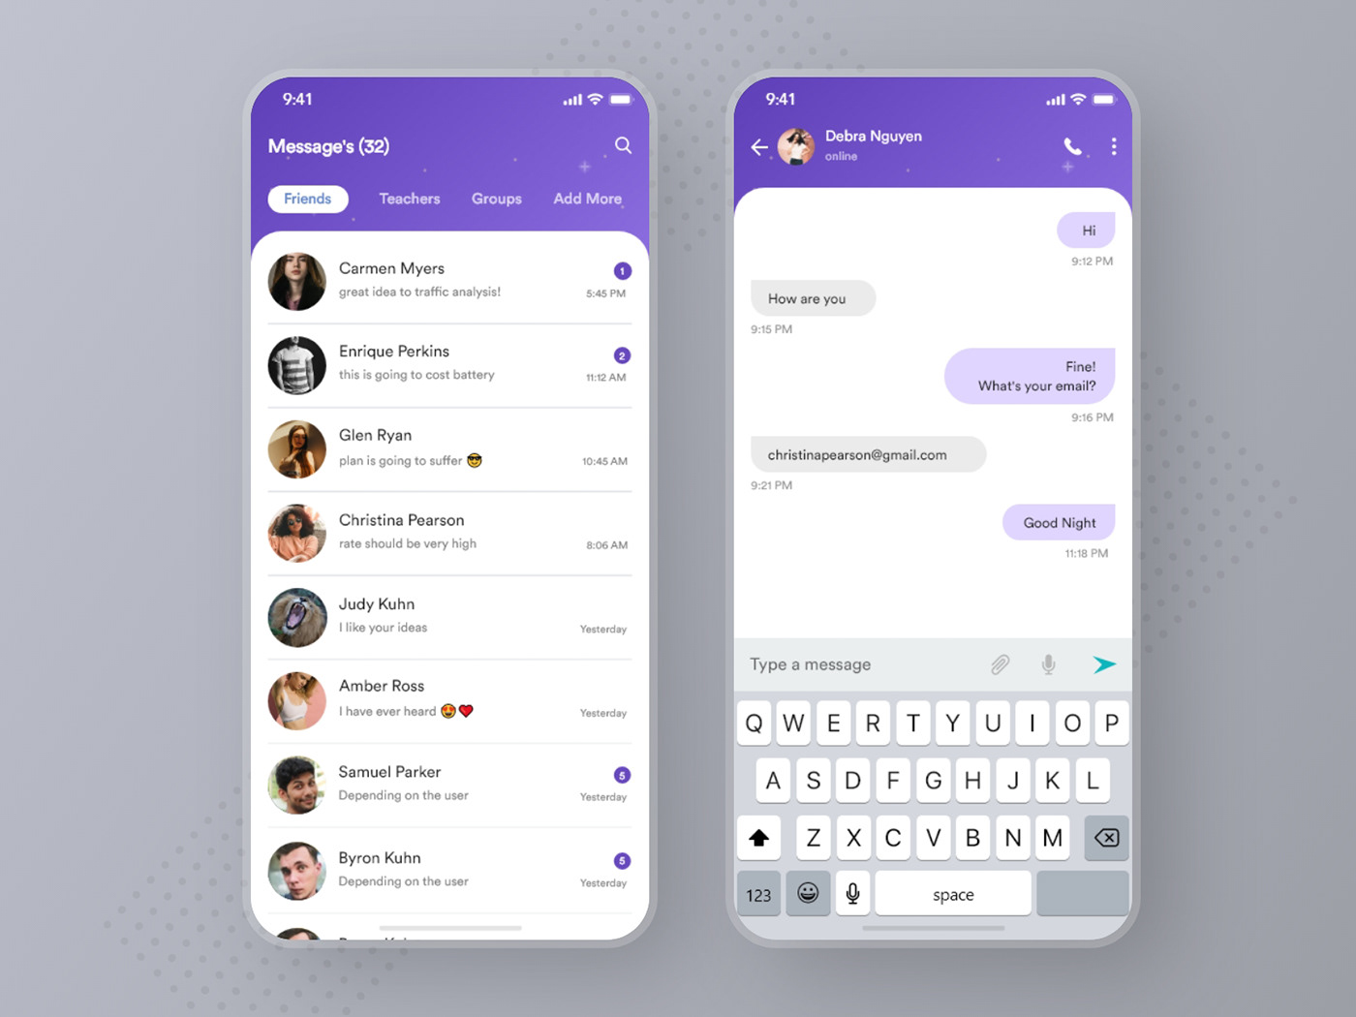
Scalability Solutions
Adopts cloud-based infrastructure, allowing automatic scaling based on user demand and ensuring high availability.

Slide 9
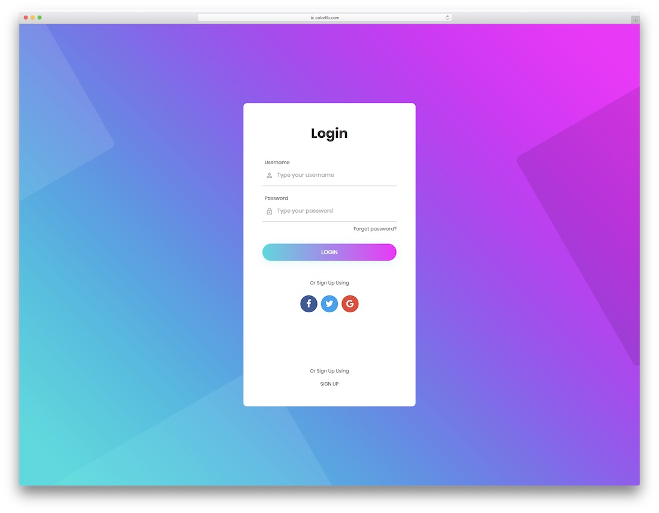
Security Measures
Utilizes encryption protocols for data protection, two-factor authentication, and regular security audits to safeguard user data.

Slide 10

Conclusions
In conclusion, real-time one-to-one chat platforms are essential for modern communication strategies. They enhance customer engagement, improve response times, and offer a cost-effective solution for businesses seeking to strengthen their customer support and service delivery.

Slide 11
Thank you!
Do you have any questions?

